Slide 1
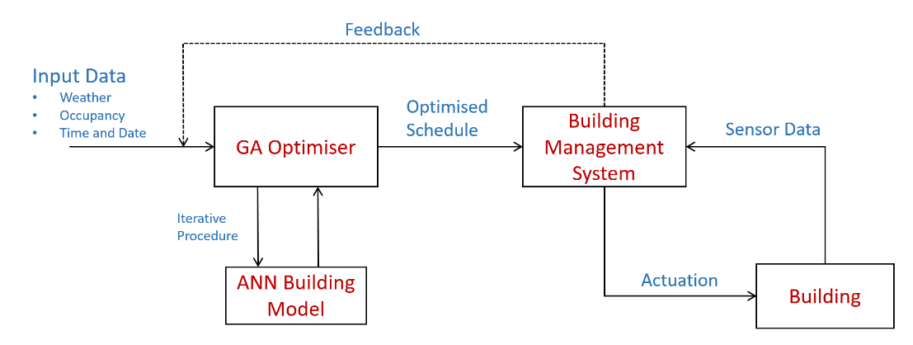
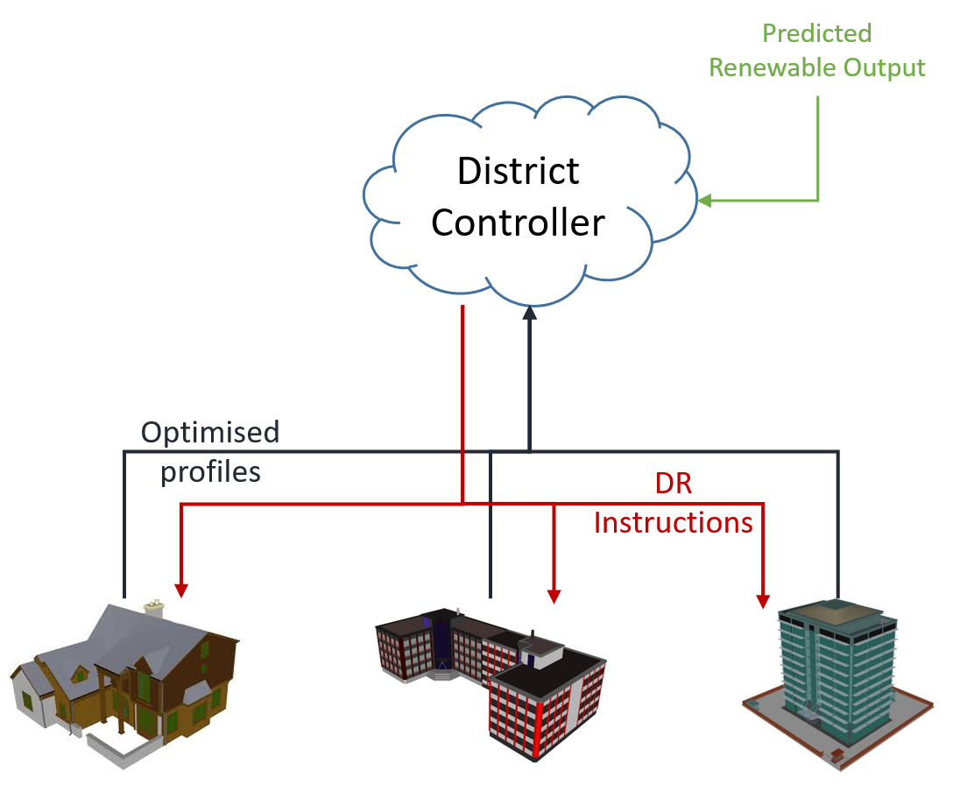
Key Facts and Research Gap
Research Aim
Buildings are responsible for 40% of global energy consumption
Introduction of new renewable energy sources adds instability and control challenges
Limited research into building control has been carried out at a district level
To comprehensively model a chosen district pilot site
To produce a building level energy optimisation strategy
To incorporate a higher level, cloud based, district controller to implement demand response strategies
Find the most appropriate control architecture for different sites
Research Approach
District modelling has been achieved using a Faro 3D laser scanner to aid the creation of as-built BIM and energy models
These have been incorporated into our own Computational Urban Sustainability Platform which engagingly displays relevant information to the user
The development of building energy models allows the training of surrogate models such as ANN
These can be coupled with optimisation strategies to implement a model predictive control strategy that minimises energy consumption
A cloud based district controller will receive the optimised building schedules
After aggregation of building and renewable energy profiles it will impose restrictions to ‘flatten’ the net energy consumption and maximise use of renewable energy
Thesis Title: Real-time And Semantic Energy Management Across Buildings In A District Configuration
Supervisors: Prof. Y. Rezgui, Prof. A. Kwan

